Slide 1
Employee Data Analysis using Excel
STUDENT NAME : Padmavathi.S
REGISTER NO : 312214929
DEPARTMENT : B.com (G)
COLLEGE : Annai veilakanni’s for women college

Slide 2
PROJECT TITLE
Employee fitness progress chart using Excel

Slide 3


AGENDA
Problem Statement
Project Overview
End Users
Our Solution and Proposition
Dataset Description
Modelling Approach
Results and Discussion
Conclusion
3/21/2024 Annual Review

Slide 4

PROBLEM STATEMENT
Accurately evaluate employee fitness details
Idntify chest , weight , hips , forearm
Develop target With fitness details

Slide 5

PROJECT OVERVIEW
Analysis employee fitness data to identify key drivers
Develop data- driven insights to inform talent management decisions,training programs and leadership development initiatives
Focus on identifying key predictors of performance , area of improvement and opportunities for growth and development

Slide 6

OUR SOLUTION AND ITS VALUE PROPOSITION
Solution : Increased productivity
Reduced absenteeism
Lower healthcare costs
Improved work culture
Reduced stress:

Slide 7
Dataset Description
Description : This data set contains information on employee fitness
Fields
This datasheet contains employee fitness details
Fields:
Weight
Waist
Hips
forearm

Slide 8

THE "WOW" IN OUR SOLUTION
Increasing employees’ physical activity can create a healthier workforce, increase employees’ productivity, and decrease employees’ risk of developing costly and debilitating chronic diseases. Employees who are physically active have lower healthcare costs, require less sick leave, and are more productive at work.
3/21/2024 Annual Review
8

Slide 9
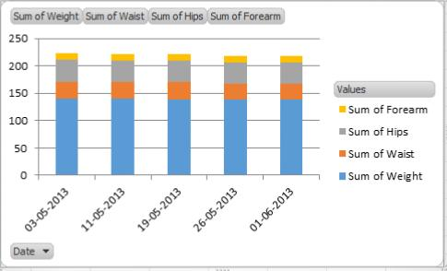
RESULTS
9

Slide 10
conclusion
The main conclusions of the research on physical fitness are that physical fitness level, exercise frequency, and physical injury are the key factors affecting physical fitness and have a serious impact on public health.

